Slide 1

Capstone Project – I: Review – 2 on
AI-Driven Intrusion Detection
System for internal Network Security
Presented by the Batch No. : CS 06
Vasa Hemesh BU22CSEN0400276
Venkat Aryan BU22CSEN0400045
Kondoju Likhitha BU22CSEN0400228
Charan Teja Reddy BU22CSEN0400145
Under the Guidance of
Dr. Dayananda Lal N
Assistant Professor
Department of Artificial Intelligence & Data Science
GITAM School of CSE, GITAM (Deemed to be University),
Bengaluru, Karnataka, INDIA.

Slide 2

CONTENTS
Recap of Capstone Project Introduction Review-2
  Problem Statement
  Objectives and Project Workflow
  Feedback from Guide/Reviewers and actions taken after Review–2
Methodology/Algorithms
Status of Implementation
Conclusion
References

Slide 3
Problem Statements
Traditional firewalls and signature-based IDS/IPS fail to detect insider threats, and lateral movements, leaving critical gaps in internal security. To address this, an AI-driven IDS will be addressed, with machine learning and correlation techniques to detect anomalies, minimize false positives, and provide real-time visualization of attack patterns.

Slide 4
Objectives
To build a modular system for real-time internal traffic capture using ML-based threat detection with Scapy and models as XGBoost, for novel attack detection isolation forest.
To evolve threat landscape for autonomous updating and detection model and to recognize novel attack patterns.
To develop an incident response system that analyzes threats, proactive mitigation steps, and to reduce reliance on manual intervention and ensuring faster containment.

Slide 5
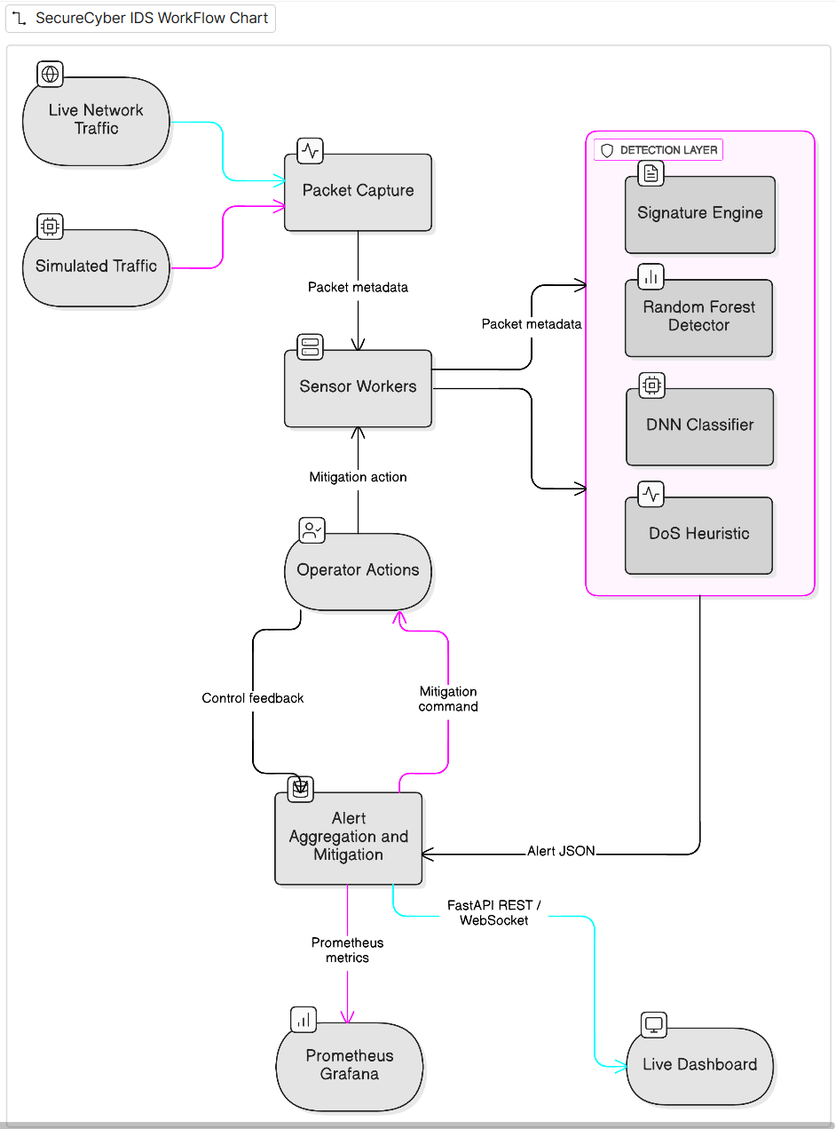
Design Strategy
Project Workflow

Slide 6
Feedback from Guide/Reviewers and actions taken after Review–1
Feedback from Guide/Reviewers
Only some team members was answering questions – others were silent involve everyone.
Know more about the technology and the model which you choose
Actions taken
Conducted weekly internal review sessions to ensure all members understood each module.
Conducted a clear study in the models Random forest , DNN , EGBoost

Slide 7
CONTENTS
Recap of Capstone Project Introduction Review-2
  Problem Statement
  Objectives and Project Workflow
  Feedback from Guide/Reviewers and actions taken after Review–2
Methodology/Algorithms
Status of Implementation
Conclusion
References

Slide 8
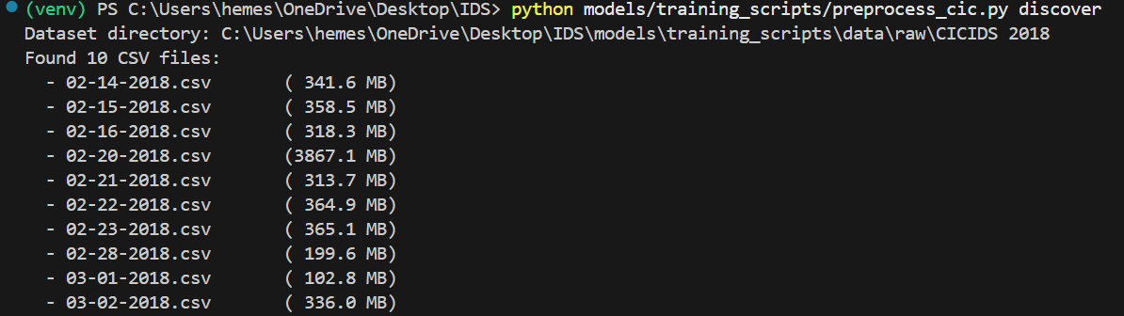
Methodology
We first loaded all the CICIDS 2018 datasets and then selects 17 features from CIC-IDS2018 that have the closest semantic meaning to what can be extracted from live packets:
Training Features (CIC-IDS2018):
Port numbers, protocol, packet lengths
TCP flags (SYN, ACK, FIN, RST, PSH, URG)
Packet rates, header lengths, traffic ratios

Slide 9
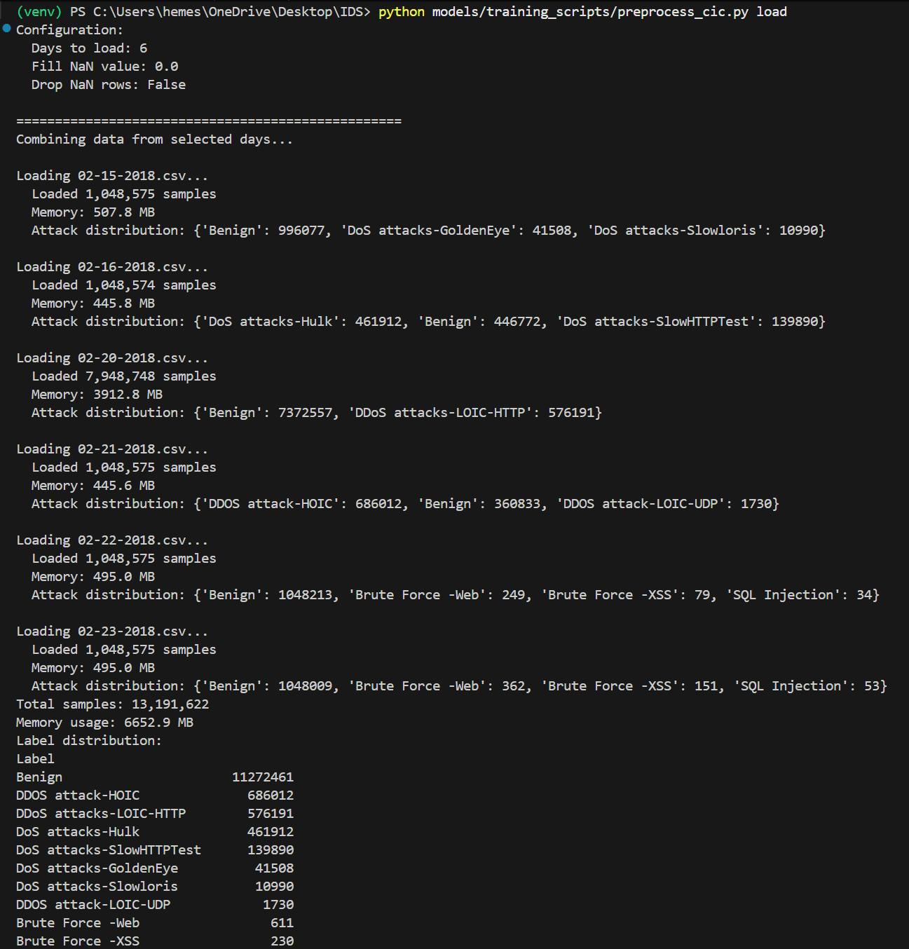
Methodology
Live Capture Features (preprocessor.py):
src_ip, dst_ip, src_port, dst_port
total_length, payload_size, ttl
tcp_syn_flag, tcp_ack_flag, tcp_fin_flag, tcp_rst_flag
window_size, sequence_number, packet_rate

Slide 10
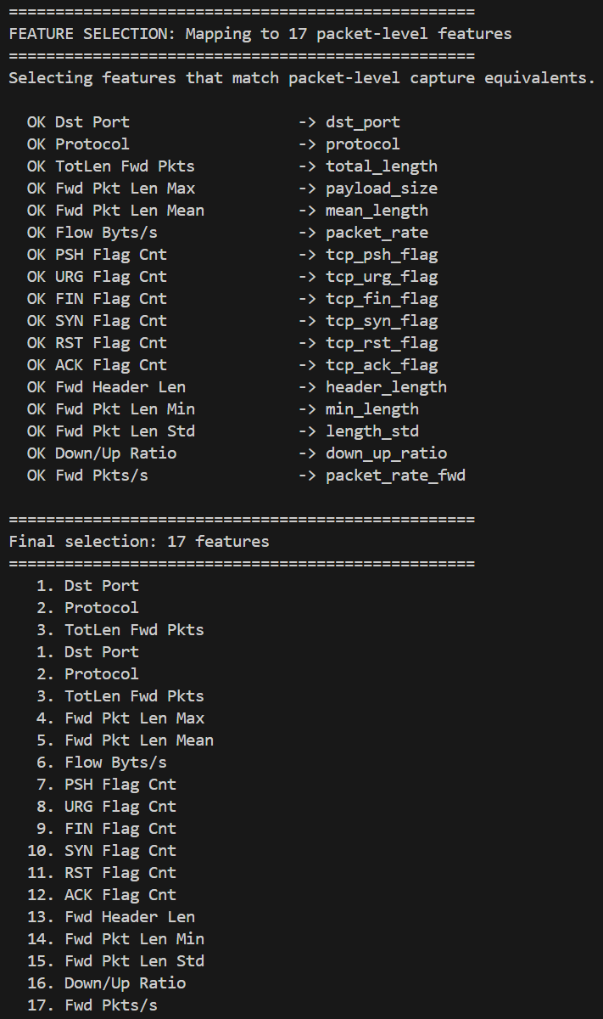
Methodology
We have extracted 17 most weighted features which are very needed to train the model which we are using xgboost which will be used here.

Slide 11
Methodology

Slide 12
Algorithm (s)

Slide 13
CONTENTS
Recap of Capstone Project Introduction Review-2
  Problem Statement
  Objectives and Project Workflow
  Feedback from Guide/Reviewers and actions taken after Review–2
Methodology/Algorithms
Status of Implementation
Conclusion
References

Slide 14
Status of Implementation
Objective-1
  Implementation details (Packages/Libraries/Classes/Methods/etc)
  Screen shots of Results

Slide 15
Status of Implementation
Objective-2
  Implementation details (Packages/Libraries/Classes/Methods/etc)
  Screen shots of Results

Slide 16
Status of Implementation
Objective-3 (if any)
  Implementation details (Packages/Libraries/Classes/Methods/etc)
  Screen shots of Results

Slide 17
Status of Implementation
Objective-4/5/6 (if any)
  Implementation details (Packages/Libraries/Classes/Methods/etc)
  Screen shots of Results

Slide 18
CONTENTS
Recap of Capstone Project Introduction Review-2
  Problem Statement
  Objectives and Project Workflow
  Feedback from Guide/Reviewers and actions taken after Review–2
Methodology/Algorithms
Status of Implementation
Conclusion
References

Slide 19
Conclusion
Summary of progress
The SecureCyber pipeline is fully wired: packet capture and simulators attacks on Backend api(host address venv); signature, RandomForest, DNN, and DoS detectors run in parallel; alerts persist in MongoDB, stream via WebSockets, and surface in Prometheus/Grafana dashboards. Training scripts for KDD/CICIDS datasets consistently regenerate the deployed models, and mitigation logic (auto/manual) is controllable via .env.
Team’s confidence on project completion
High. With the core architecture, detectors, observability stack, and automation scripts already integrated and validated end-to-end, the team is confident in delivering the remaining polish (tuning, documentation, deployment packaging) on schedule.
Expected outcomes or impact
SecureCyber will provide SOC teams a hybrid IDS/IPS capable of spotting known exploits and zero-day anomalies in near real time, pushing alerts to an actionable dashboard, and enabling rapid mitigation—including automated blocklists and analyst-approved actions. This should significantly reduce dwell time for Change Healthcare–style multi-vector attacks and harden enterprise, campus, and edge deployments.

Slide 20
CONTENTS
Recap of Capstone Project Introduction Review-2
  Problem Statement
  Objectives and Project Workflow
  Feedback from Guide/Reviewers and actions taken after Review–2
Methodology/Algorithms
Status of Implementation
Conclusion
References

Slide 21
References
Research Papers & Articles
Oluwadamilare Harazeem Abdulganiyu1 ·Taha AitTchakoucht1 ·Yakub Kayode Saheed2 Asystematic literature review for network intrusion detection system (IDS)
Düzgün, B., Çayır, A., Ünal, U., & Dağ, H. (2024). Network Intrusion Detection System by Learning Jointly from Tabular and Text-Based Features.
Sowmya, T., et al., A comprehensive review of AI based intrusion detection approaches in cloud and network environments. (2023).
Nagaraja, G.S., Real-Time Intrusion Detection System Using Scapy with PyShark (SSRN preprint, 2025). — demonstrates live packet capture and real-time feature extraction.[https://papers.ssrn.com/sol3/papers.cfm?abstract_id=5349786&utm_source]

